Slide 1
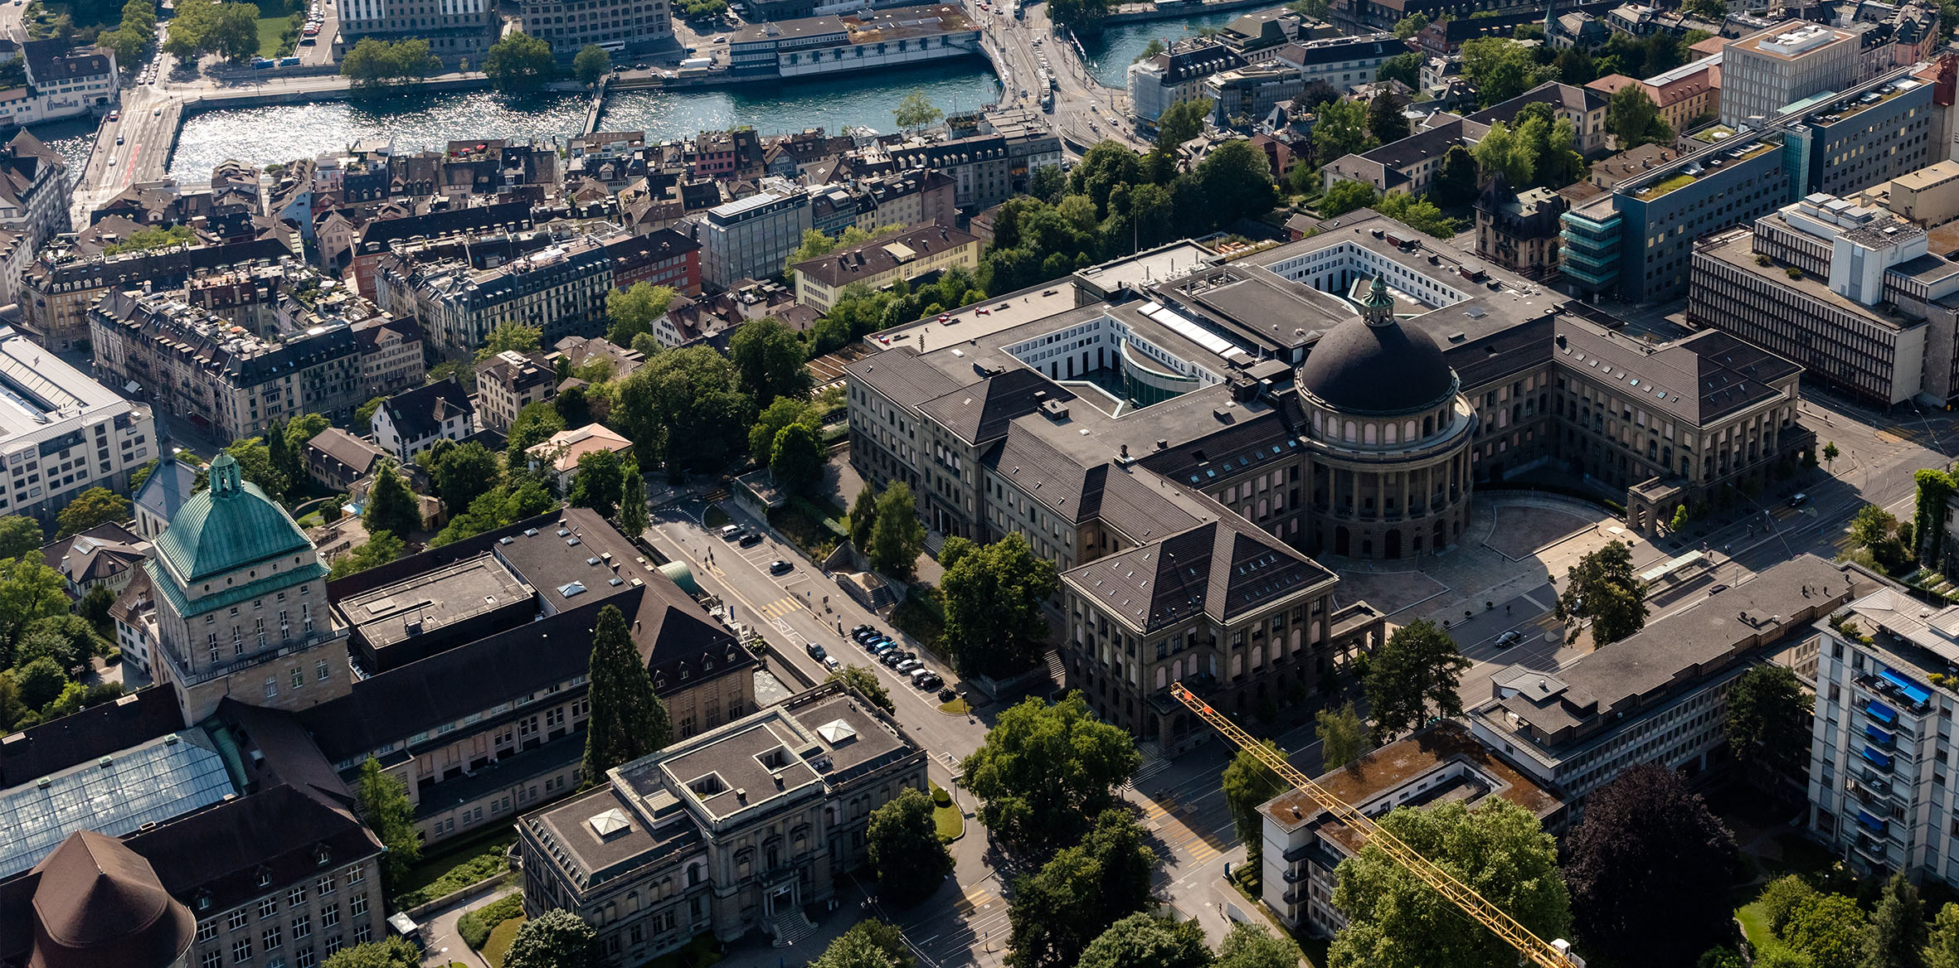
Master‘s thesis montly update
Xiaowei Lin

Slide 2
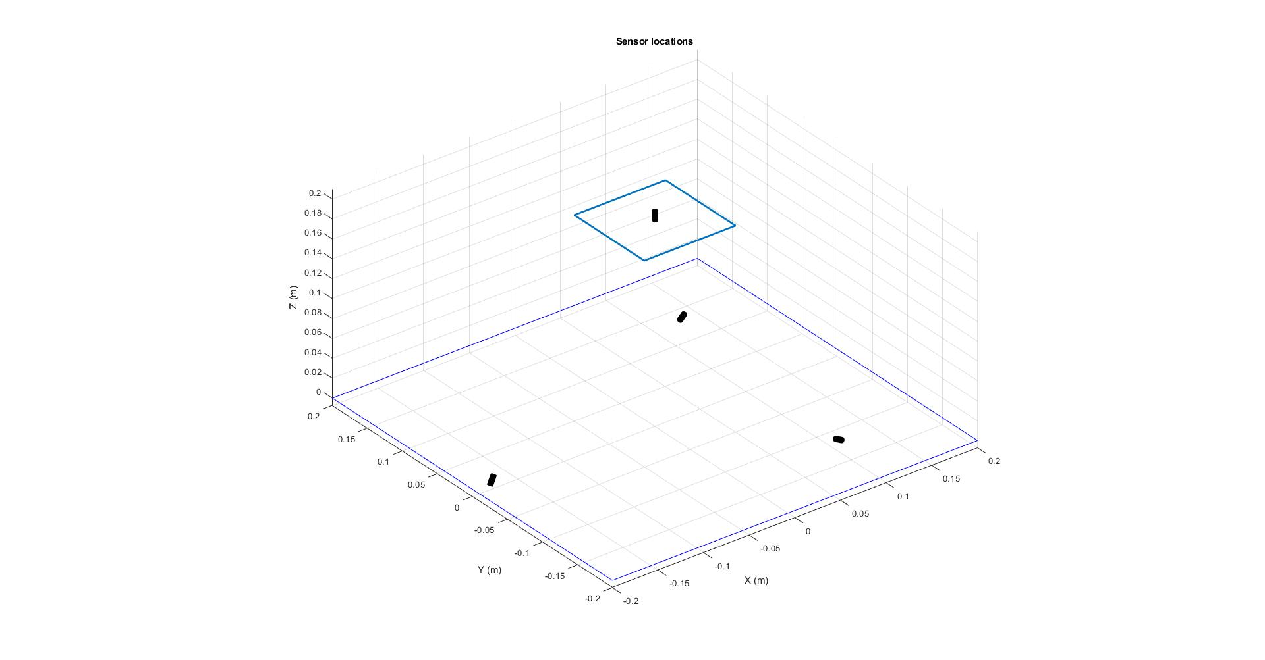
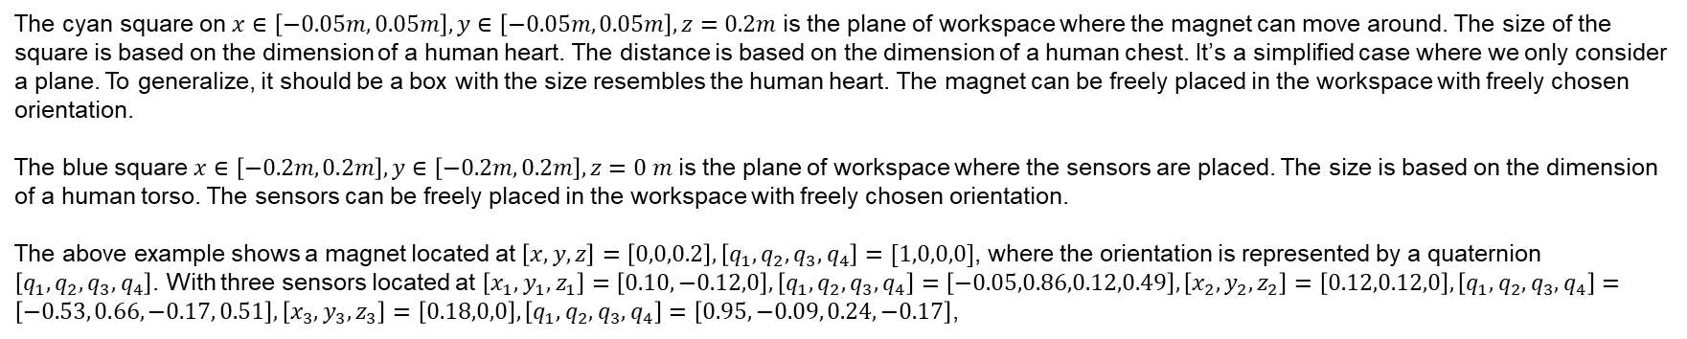
Problem description - recap
The cyan square on $x∈\left[−0.05m, 0.05m\right], y∈\left[−0.05m, 0.05m\right], z=0.2m$ is the plane of workspace where the magnet can move around. The size of the square is based on the dimension of a human heart. The distance is based on the dimension of a human chest. It’s a simplified case where we only consider a plane. To generalize, it should be a box with the size resembles the human heart. The magnet can be freely placed in the workspace with freely chosen orientation.
The blue square $x∈\left[−0.2m, 0.2m\right], y∈\left[−0.2m, 0.2m\right], z=0 m$ is the plane of workspace where the sensors are placed. The size is based on the dimension of a human torso. The sensors can be freely placed in the workspace with freely chosen orientation.
The above example shows a magnet located at $\left[x, y, z\right]=\left[0,0,0.2\right], \left[q_{1}, q_{2}, q_{3},q_{4}\right]=[1,0,0,0]$, where the orientation is represented by a quaternion $\left[q_{1}, q_{2}, q_{3},q_{4}\right]$. With three sensors located at $\left[x_{1}, y_{1}, z_{1}\right]=\left[0.10,−0.12,0\right], \left[q_{1}, q_{2}, q_{3},q_{4}\right]=\left[−0.05,0.86,0.12,0.49\right],\left[x_{2}, y_{2}, z_{2}\right]=\left[0.12,0.12,0\right], \left[q_{1}, q_{2}, q_{3},q_{4}\right]=\left[−0.53, 0.66, −0.17, 0.51\right],\left[x_{3}, y_{3}, z_{3}\right]=\left[0.18,0,0\right], \left[q_{1}, q_{2}, q_{3},q_{4}\right]=\left[0.95, −0.09, 0.24, −0.17\right]$,

Slide 3
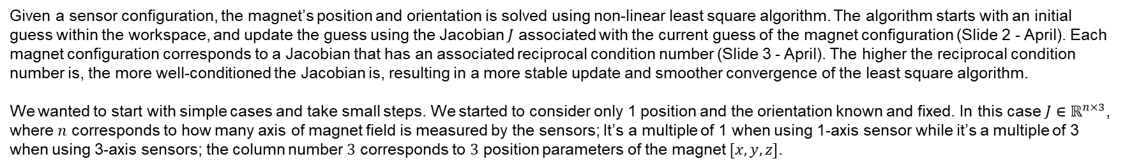
Problem description - recap
Given a sensor configuration, the magnet’s position and orientation is solved using non-linear least square algorithm. The algorithm starts with an initial guess within the workspace, and update the guess using the Jacobian $J$ associated with the current guess of the magnet configuration (Slide 2 - April). Each magnet configuration corresponds to a Jacobian that has an associated reciprocal condition number (Slide 3 - April). The higher the reciprocal condition number is, the more well-conditioned the Jacobian is, resulting in a more stable update and smoother convergence of the least square algorithm.
We wanted to start with simple cases and take small steps. We started to consider only 1 position and the orientation known and fixed. In this case $J∈ℝ^{n×3}$, where $n$ corresponds to how many axis of magnet field is measured by the sensors; It’s a multiple of 1 when using 1-axis sensor while it’s a multiple of 3 when using 3-axis sensors; the column number $3$ corresponds to $3$ position parameters of the magnet $[x, y, z]$.

Slide 4
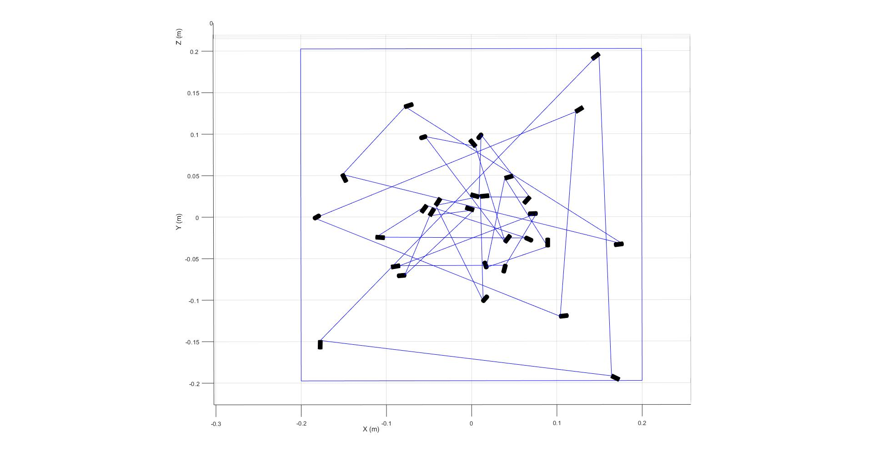
Only 1 position‘s optimal Jacobian
For only 1 position, the Jacobian can be optimal (reciprocal condition number = 1) for different sensors’ location. We tried to find if there is geometric relationship between each solution such that we can generalize the optimal result, at least for only 1 position’s Jacobian. We used genetic algorithm to output 10 sensor configurations that has the optimal result for the center position of the magnet space. And the result is quite random:
We figured it’s overly complicated to generalize the result, even for only 1 position. And we decided to move on to the numerical method, using the genetic algorithm in MATLAB’s optimization toolbox.

Slide 5

Considering multiple magnet‘s positions
It’s easy for the genetic algorithm to find the optimal sensor configuration when only considering one sensor position. However, what we are really interested in is the Jacobian’s property for all magnet’s configurations in the workspace. For that, we take one small step to enlarge the magnet workspace from a single position to a plane of positions at $x∈\left[−0.05m, 0.05m\right], y∈\left[−0.05m, 0.05m\right], z=0.2m$, as shown on slide 2. In the continuous case, there are infinite amount of positions that we are considering, which is impossible to solve. To simplify the problem, we decided to gridify the workspace to a certain amount, and only consider the positions on the grids. To further simplify the

Slide 6
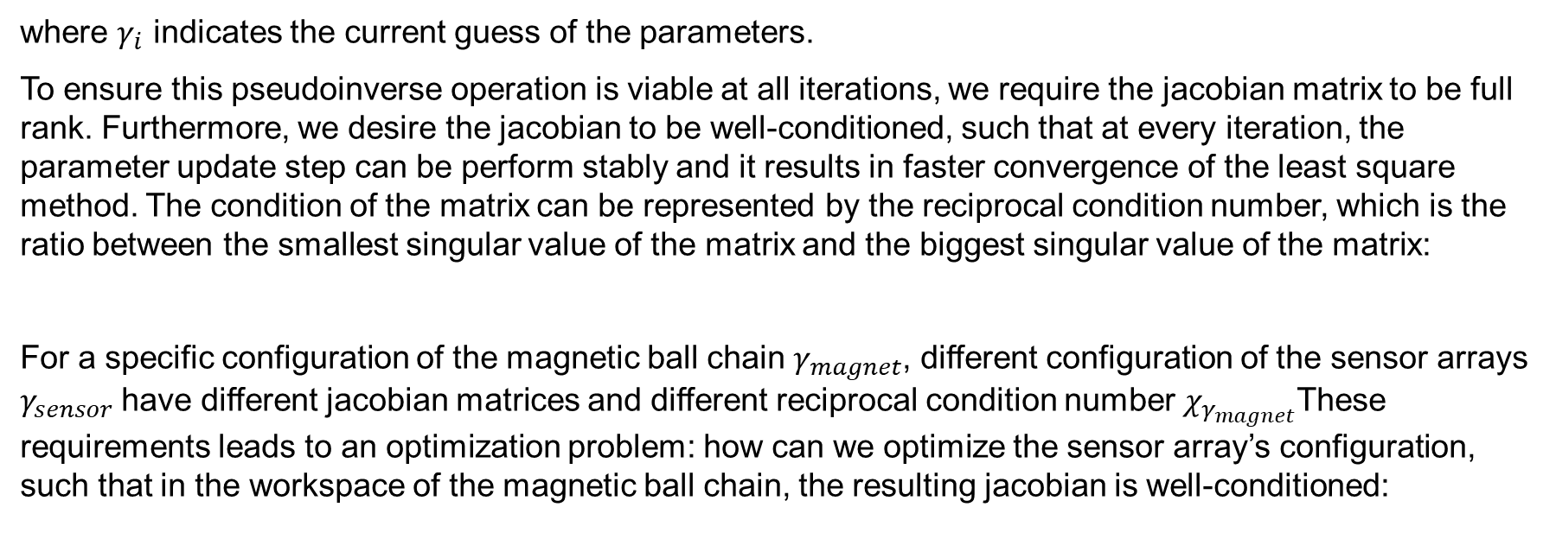

Problem description
And the pseudoinverse of this jacobian is taken to update the guess of the parameters:
$$∆γ=J^{†}(B−B\left(γ_{i}\right))$$
where $γ_{i}$ indicates the current guess of the parameters.
To ensure this pseudoinverse operation is viable at all iterations, we require the jacobian matrix to be full rank. Furthermore, we desire the jacobian to be well-conditioned, such that at every iteration, the parameter update step can be perform stably and it results in faster convergence of the least square method. The condition of the matrix can be represented by the reciprocal condition number, which is the ratio between the smallest singular value of the matrix and the biggest singular value of the matrix:
For a specific configuration of the magnetic ball chain $γ_{magnet}$, different configuration of the sensor arrays $γ_{sensor}$have different jacobian matrices and different reciprocal condition number $χ_{γ_{magnet}}$These requirements leads to an optimization problem: how can we optimize the sensor array’s configuration, such that in the workspace of the magnetic ball chain, the resulting jacobian is well-conditioned:
$$χ=\frac{σ_{min}}{σ_{max}}$$
$${}_{γ_{sensor}}^{max}{ χ_{i} ∀i∈γ_{magnet}}$$

Slide 7
Problem description
Furthermore, we also would like to maximize the signal to noise ratio $SNR$ of each sensor, such that the sensors’ outputs are more reliable. The resulting problem becomes a multi-objective optimization problem:
$${}_{γ_{sensor}}^{max}{{ χ}_{i }, {SNR}_{i} ∀i∈γ_{magnet}}$$

Slide 8
Sensor selection
We first investigate different types of sensor with their specifications. Our requirement is to accurately detect the magnetic field generated by 10 magnetic balls of different diameters in the ball chain at a distance of ..cm (workspace requirement). We put together a list of different sensors and their corresponding capability of sensing the magnetic ball chain of different diameters is indicated. The leftmost column indicates what diameter of the 10 magnetic balls in the chain can be tracked with a signal to noise ratio of >60. The 8th column indicates the sensor’s root mean square noise level at the desired working frequency of ~500 Hz. The colored section indicates the signal to noise ratio. Green section means SNR>60, orange section means 30<SNR<60.
 |  |  |  |  |  |  |  | 10 ⌀ 2.5 mm N42 250 nT | 10 ⌀ 3.175 mm N42 550 nT | 10 ⌀ 4.763 mm N42 1850 nT | 10 ⌀ 6.35 mm N42 4350 nT
2.5mm | Stefan Mayer Instruments FL1-100 | 1-axis | Fluxgate | Analog | 1-4: $430 5-9: $385 | ±100 | 0.5 nT @ 500 Hz | 500 | 1100 | 3700 | 8700
2.5mm | Stefan Mayer Instruments FLC3-70 | 3-axis | Fluxgate | Analog | 1-4: $593 5-9: $563 | ±200 | 1.5 * sqrt(3) nT @ 500 Hz | 167 | 366 | 1234 | 2900
2.5mm | Stefan Mayer Instruments FLC-100 | 1-axis | Fluxgate | Analog | 5-9: $85 | ±100 | 3.4 nT @ 500 Hz | 74 | 161 | 544 | 1280
3/16 inch | PMI RM3100 | 3-axis | Inductive | Digital | $60 ($40 business) | ±800 | 17 * sqrt (3) nT @ 534 Hz | 15 | 33 | 109 | 256
1/4 inch | Texas Instrument DRV425 | 1-axis | Fluxgate | Analog | $24 | ±2000 | 44 nT @ 500 Hz | 6 | 13 | 42 | 99
1/4 inch | Memsic MMC5983MA | 3-axis | Resistive | Digital | $22 | ±800 | 70 nT * sqrt(3) @ 580 Hz | 4 | 8 | 27 | 62

Slide 9
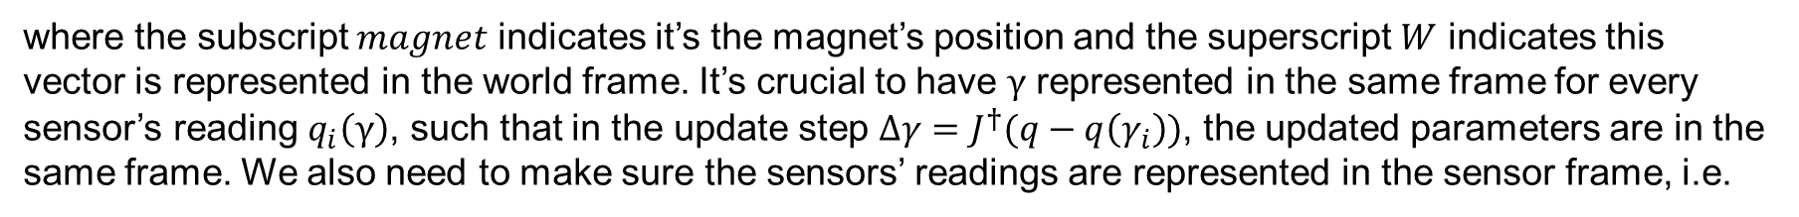
Optimization
We start from the very basic case, where we only consider a single magnet in the work space with its orientation fixed, and construct the optimization problem accordingly. In this case, the magnet configuration parameters are just its position in the workspace:
$$γ=r_{magnet}^{W}={{\left[x, y, z\right]}^{T}}^{W}$$
where the subscript $magnet$ indicates it’s the magnet’s position and the superscript $W$ indicates this vector is represented in the world frame. It’s crucial to have $γ$ represented in the same frame for every sensor’s reading $q_{i}\left(γ\right)$, such that in the update step $∆γ=J^{†}(q−q\left(γ_{i}\right))$, the updated parameters are in the same frame. We also need to make sure the sensors’ readings are represented in the sensor frame, i.e.
$$B_{i}\left(γ\right)=B_{i}^{S_{i}}\left(γ\right)$$
such that the sensors’ orientation information is captured by the sensors’ readings. The overall relationship of sensors’ outputs and magnet configuration becomes:
$$B\left(γ\right)={\left[B_{1}^{S_{1}}\left(r_{magnet}^{W}\right) B_{2}^{S_{2}}\left(r_{magnet}^{W}\right) … B_{m}^{S_{m}}\left(r_{magnet}^{W}\right)\right]}^{T}∈R^{3m}$$

Slide 10
Optimization
The corresponding jacobian for one sensor can be calculated as:
$$\frac{∂B_{i}^{S_{i}}\left(r_{magnet}^{W}\right)}{∂r_{magnet}^{W}}=\frac{∂B_{i}^{S_{i}}}{∂r_{i}^{S_{i}}}\frac{∂r_{i}^{S_{i}}}{∂r_{i}^{w}}\frac{∂r_{i}^{w}}{∂r_{magnet}^{W}}$$
where $r_{i}^{S_{i}}$ is the vector from the magnet position to the sensor $i$’s position, i.e. $r_{i}^{S_{i}}=r_{S_{i}}^{S_{i}}−r_{magnet}^{S_{i}}$, and the $r_{i}^{w}$ is same vector represented in the world frame. This expression of the jacobian is:
$$\frac{∂B_{i}^{S_{i}}\left(r_{magnet}^{W}\right)}{∂r_{magnet}^{W}}=\frac{3μ_{0}}{4π}\frac{\left|μ^{S_{i}}\right|}{{\left|r_{i}^{S_{i}}\right|}^{4}}\left(\left(I−5\hat{r_{i}^{S_{i}}}{\hat{r_{i}^{S_{i}}}}^{T}\right)\left({\hat{r_{i}^{S_{i}}}}^{T}\hat{μ^{S_{i}}}\right)+\hat{μ^{S_{i}}}{\hat{r_{i}^{S_{i}}}}^{T}+\hat{r_{i}^{S_{i}}}{\hat{μ^{S_{i}}}}^{T}\right)∗R_{W}^{S_{i}}∗(−I)$$
where $μ_{0}$ permeability of free space, $μ^{S_{i}}$ is the magnetic dipole moment of the magnet represented in the sensor’s frame, $\hat{μ^{S_{i}}}$ is its corresponding unit vector, $\hat{r_{i}^{S_{i}}}$ is the unit vector for $r_{i}^{S_{i}}$.

Slide 11
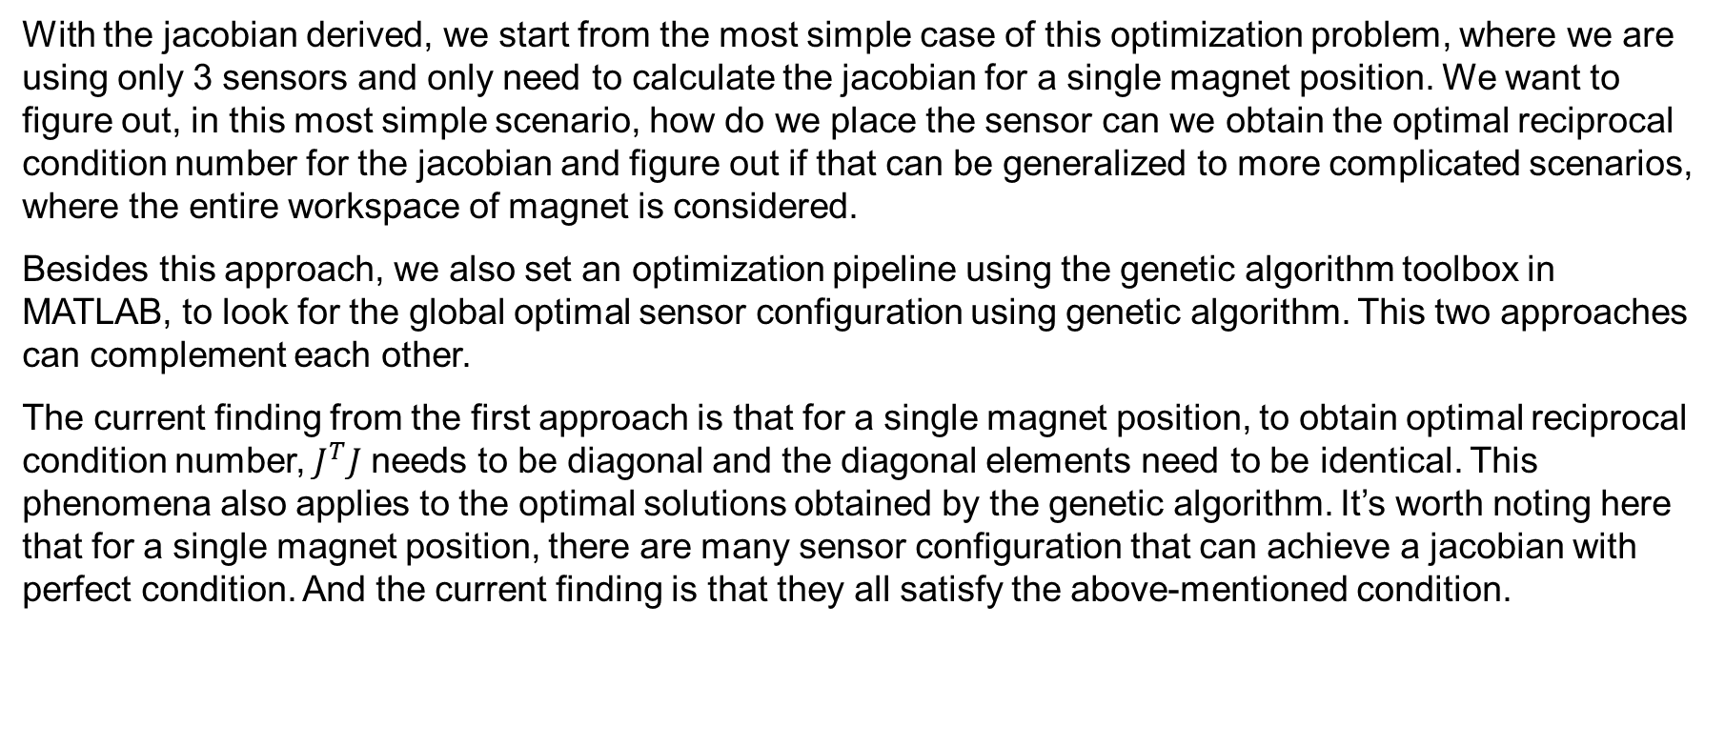
Optimization
With the jacobian derived, we start from the most simple case of this optimization problem, where we are using only 3 sensors and only need to calculate the jacobian for a single magnet position. We want to figure out, in this most simple scenario, how do we place the sensor can we obtain the optimal reciprocal condition number for the jacobian and figure out if that can be generalized to more complicated scenarios, where the entire workspace of magnet is considered.
Besides this approach, we also set an optimization pipeline using the genetic algorithm toolbox in MATLAB, to look for the global optimal sensor configuration using genetic algorithm. This two approaches can complement each other.
The current finding from the first approach is that for a single magnet position, to obtain optimal reciprocal condition number, $J^{T}J$ needs to be diagonal and the diagonal elements need to be identical. This phenomena also applies to the optimal solutions obtained by the genetic algorithm. It’s worth noting here that for a single magnet position, there are many sensor configuration that can achieve a jacobian with perfect condition. And the current finding is that they all satisfy the above-mentioned condition.

Slide 12
Next steps
The latter steps would be to figure out if it’s possible to generalize this finding, if this is viable, the genetic algorithm can be used as a back-up approach. Otherwise, we can still use the genetic algorithm to find the optimal sensor configuration, with the premise that we verify our setup is correct from the simple case where we only consider one magnet position. Then move on to: multiple magnet positions(the entire workspace); adding orientation of the magnet into consideration; adding signal to noise ratio to form a multi objective problem; adding a second magnet to form a constant curvature robot; generalize the magnetic ball chain.

Slide 13
Xiaowei Lin
xiaoweilin@student.ethz.ch
EN 353
Boston Children’s Hospital
300 Longwood Ave,
Boston, MA 02115
USA

